Slide 1
building a long and winding road
Tatiana Magalí Rodríguez
March 4, 2021

Slide 2
about myself
graduated in
2019 from Universidad Nacional de La Plata, Bs As, Argentina
As an astronomer
5 years: 3 yr general courses and 2 yr advanced classes
Also worked as
Cook, waitress, receptionist, high-school teacher, tour guide
How did I get here?
And got involved
in outreach activities and political student associations
currently
I’m a Research Assistant and Ph.D. student at New Mexico Tech, Socorro, NM.

Slide 3
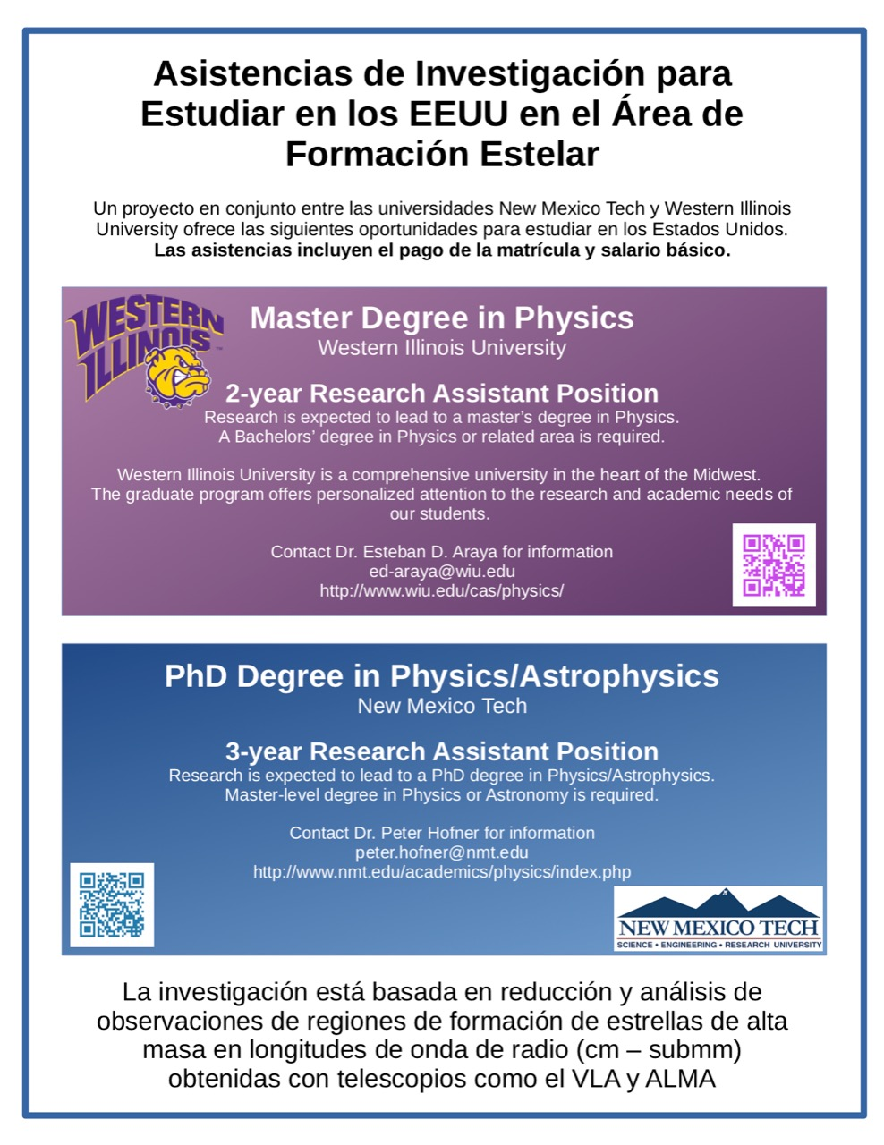
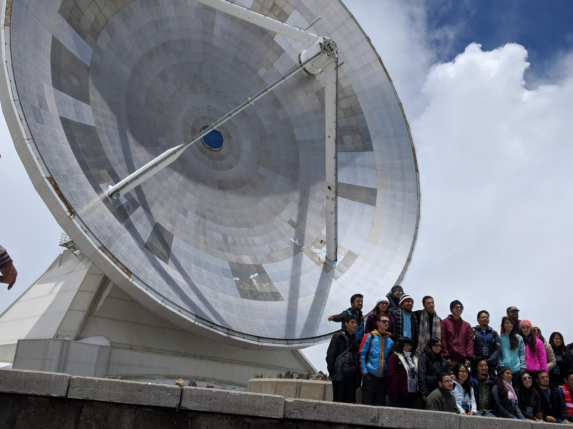
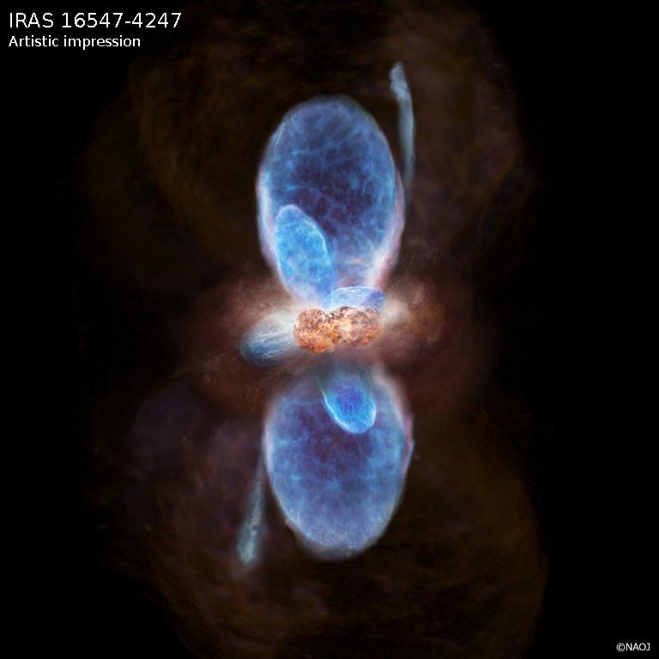
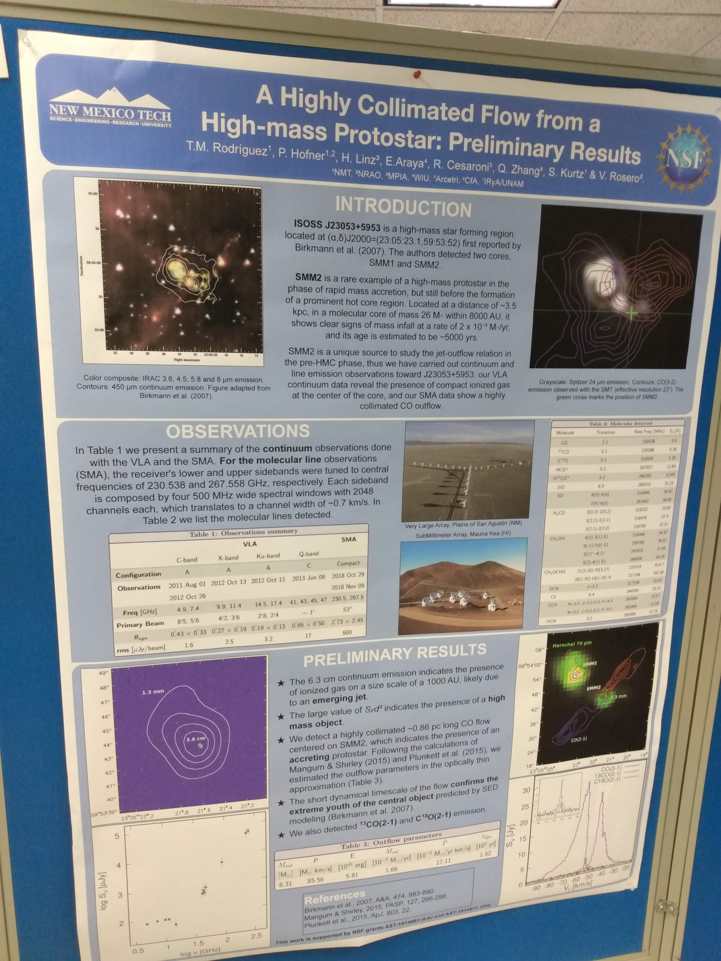
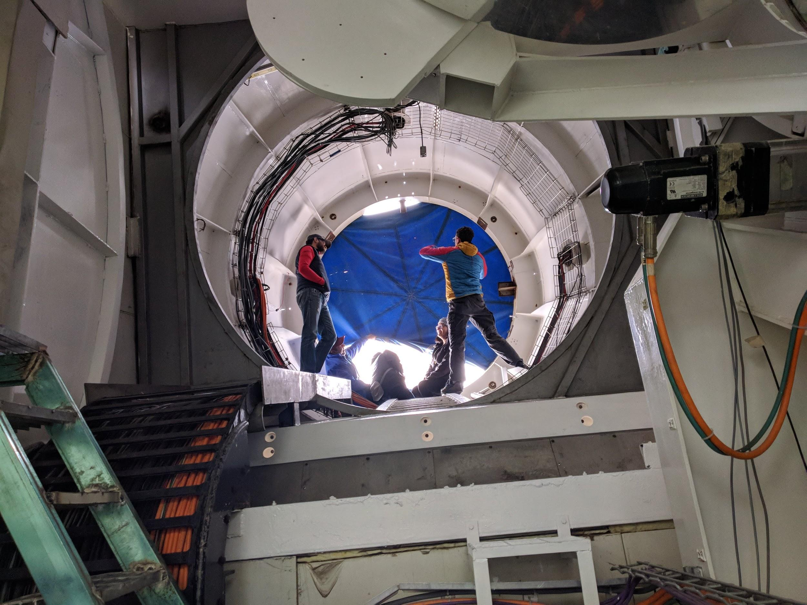
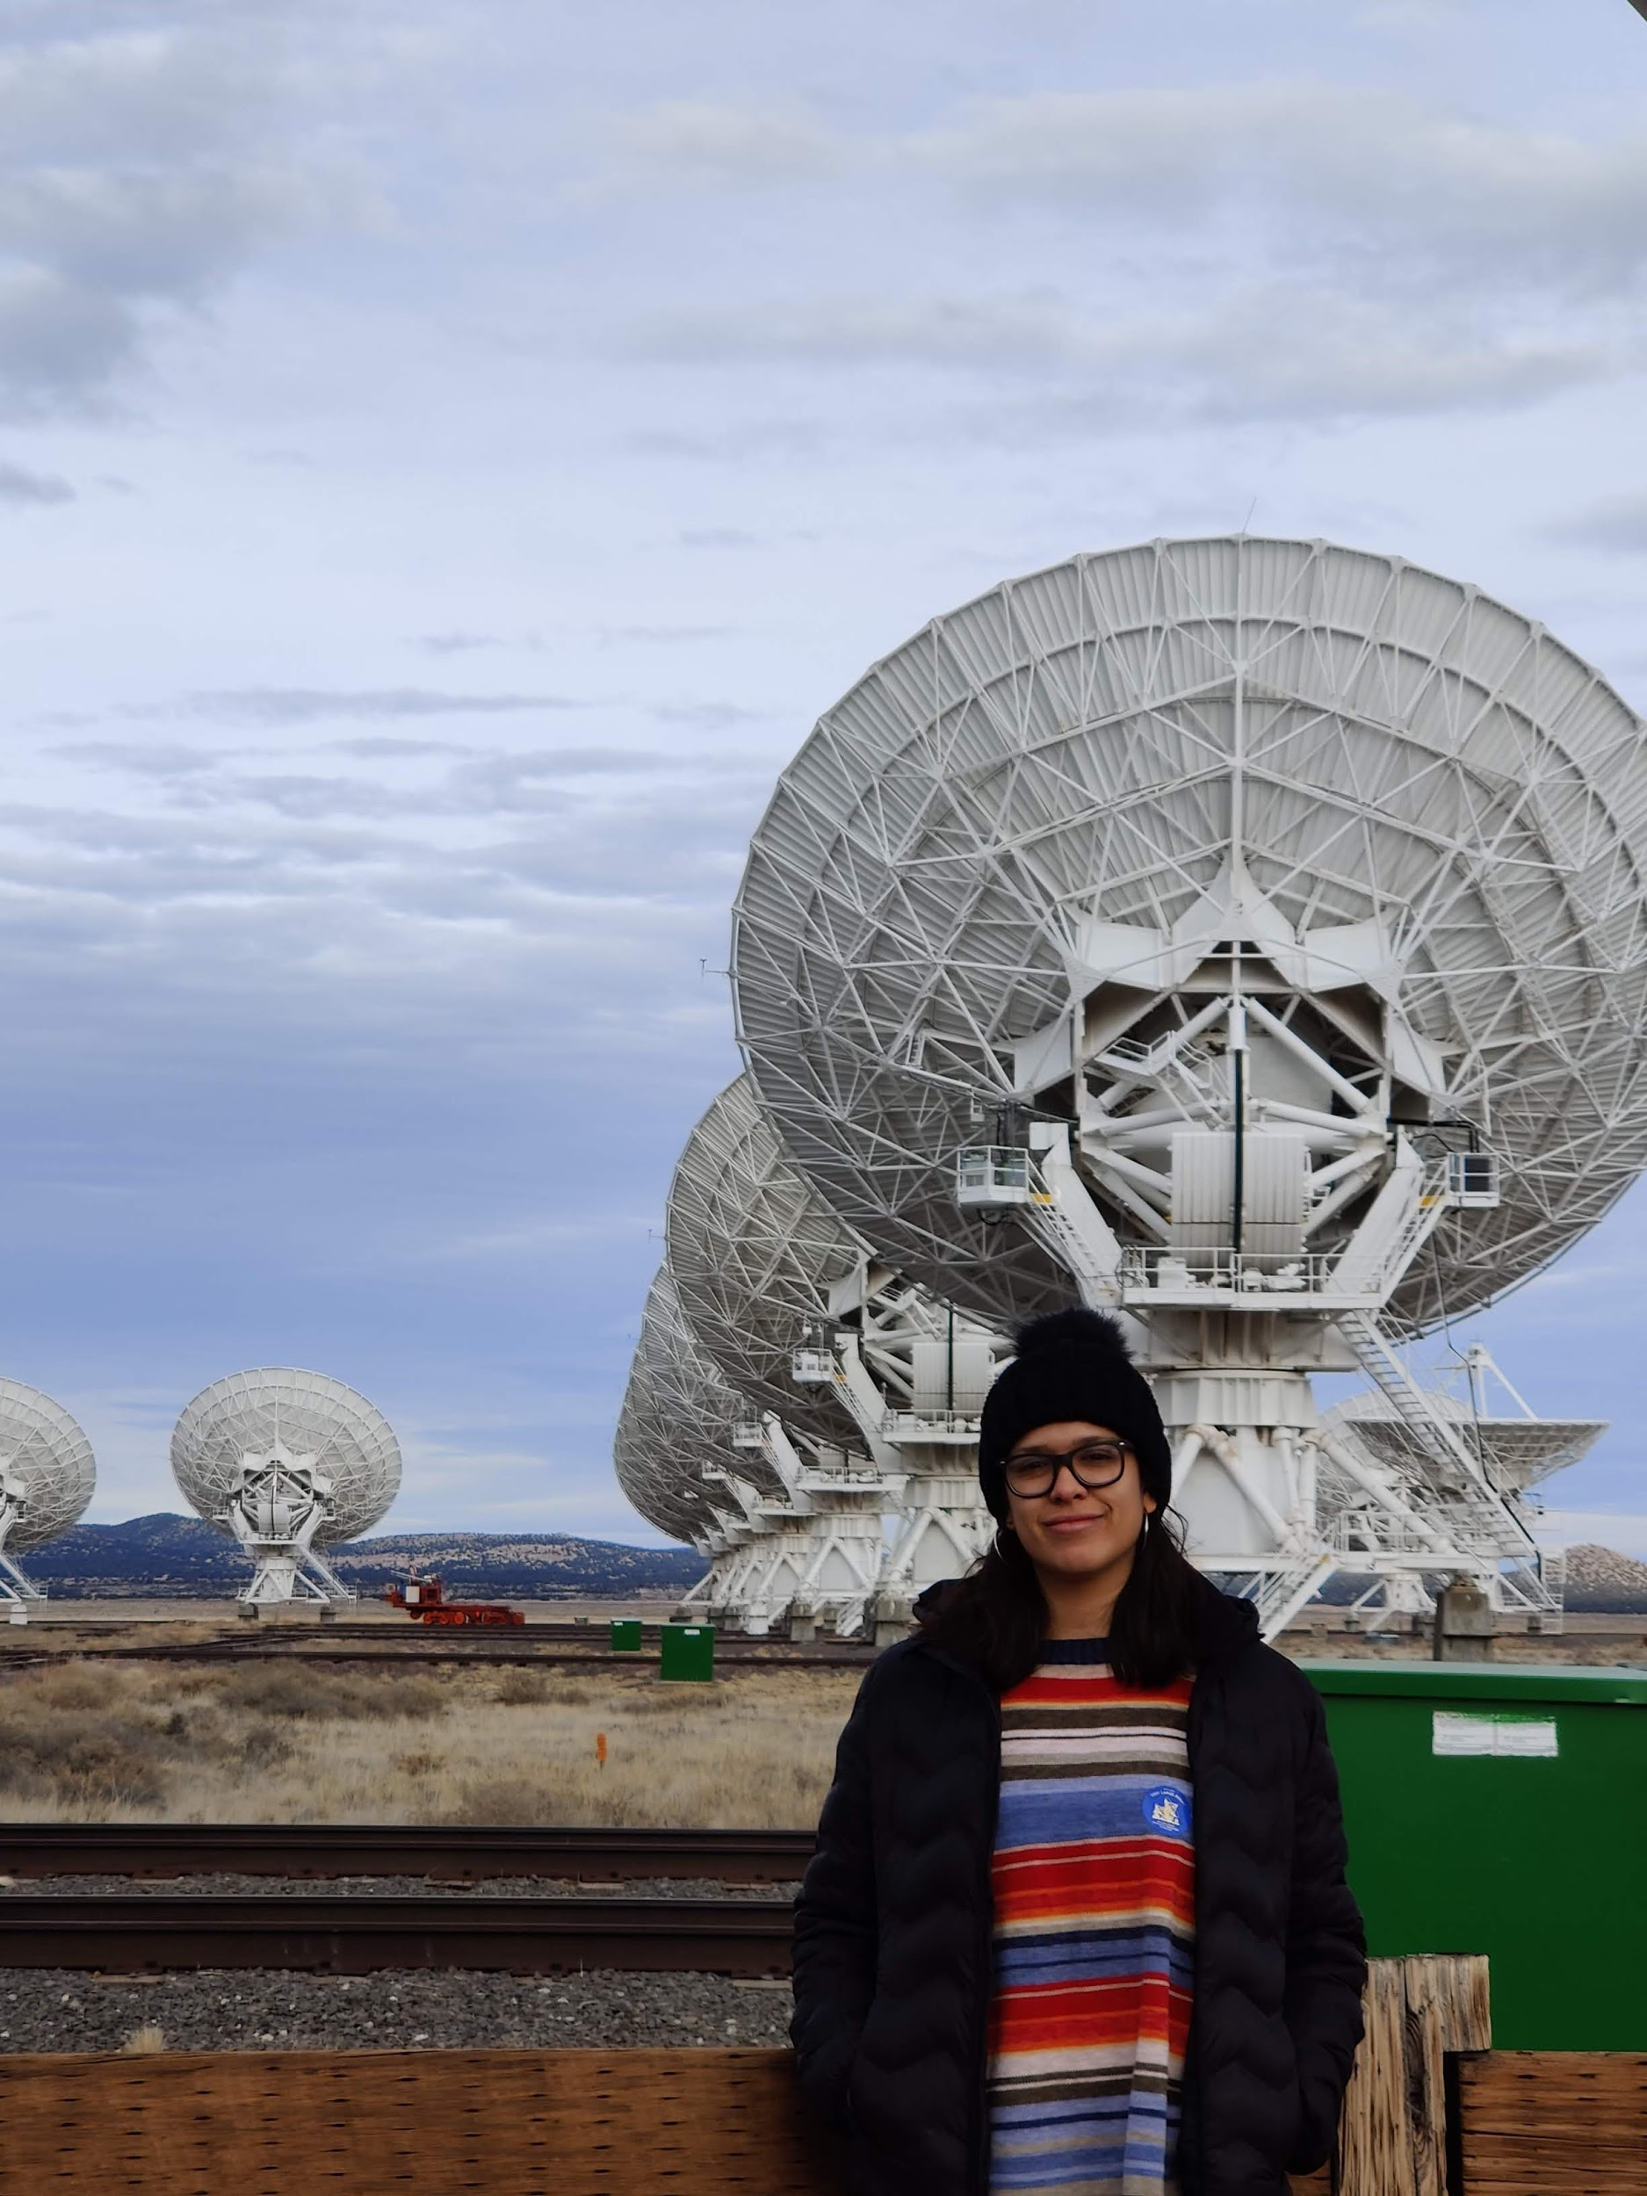
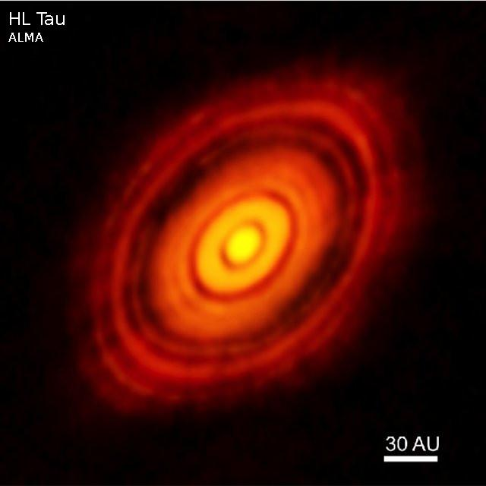
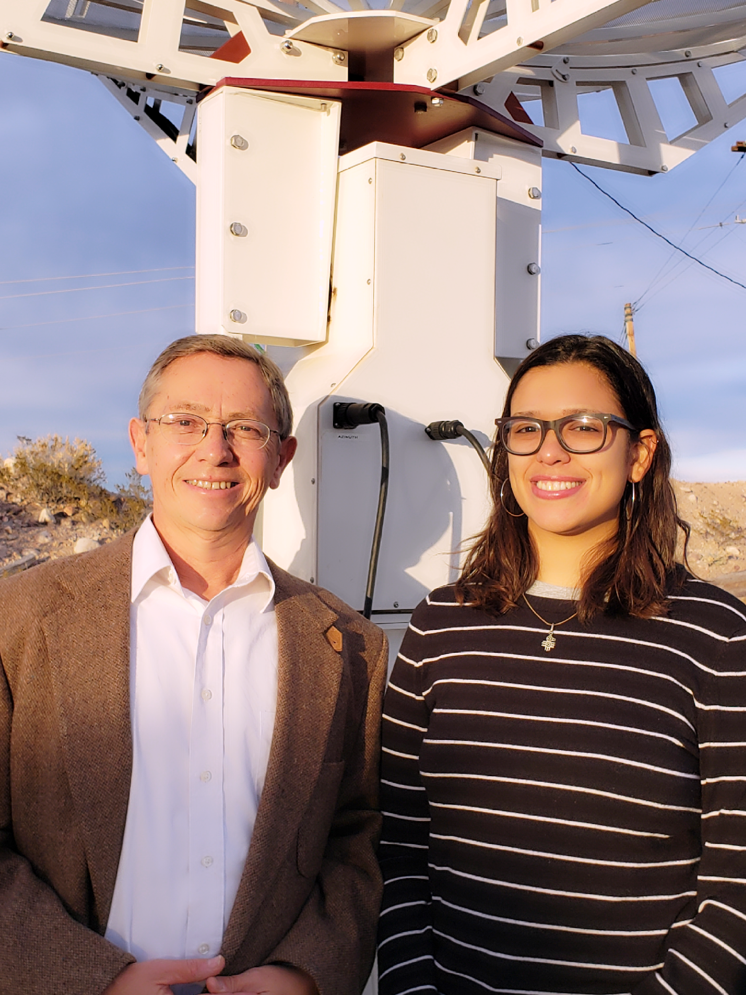

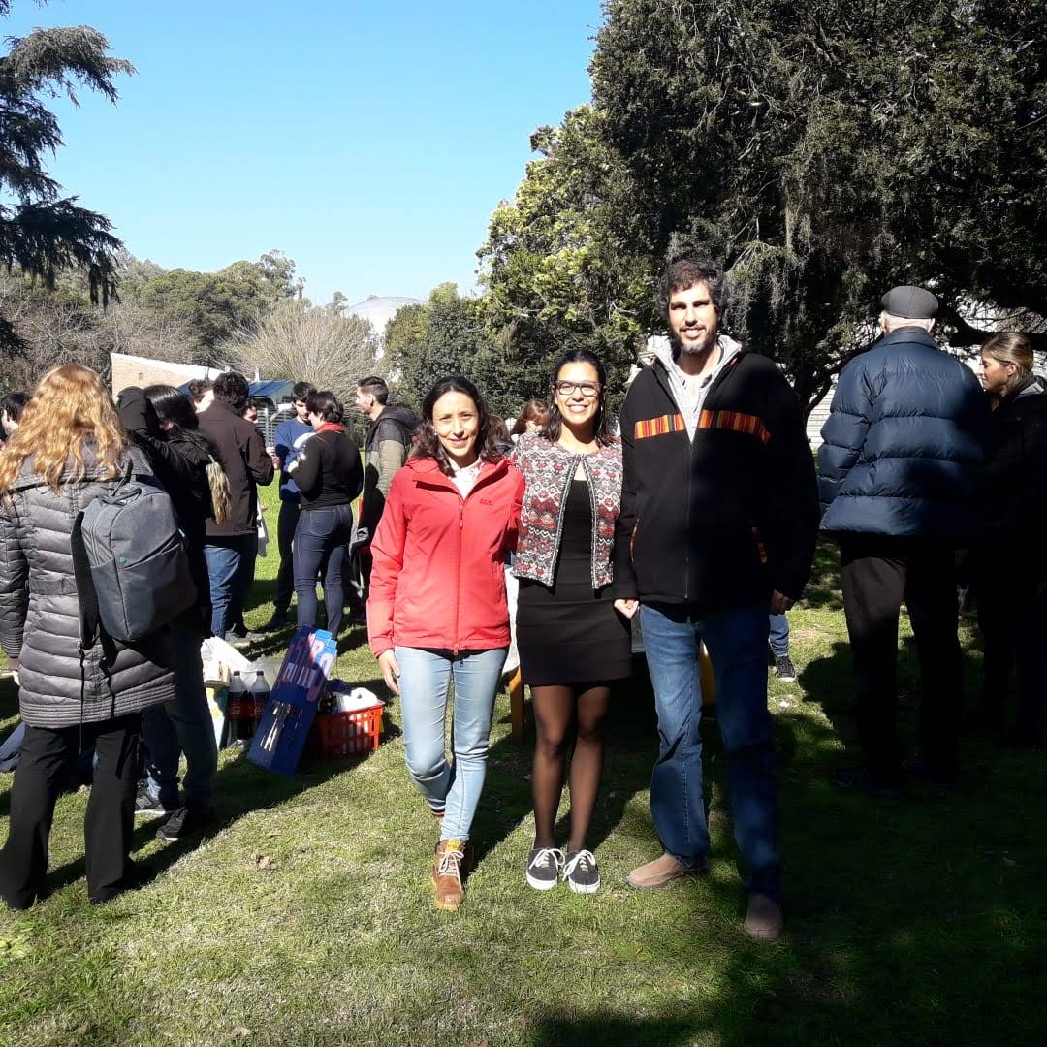
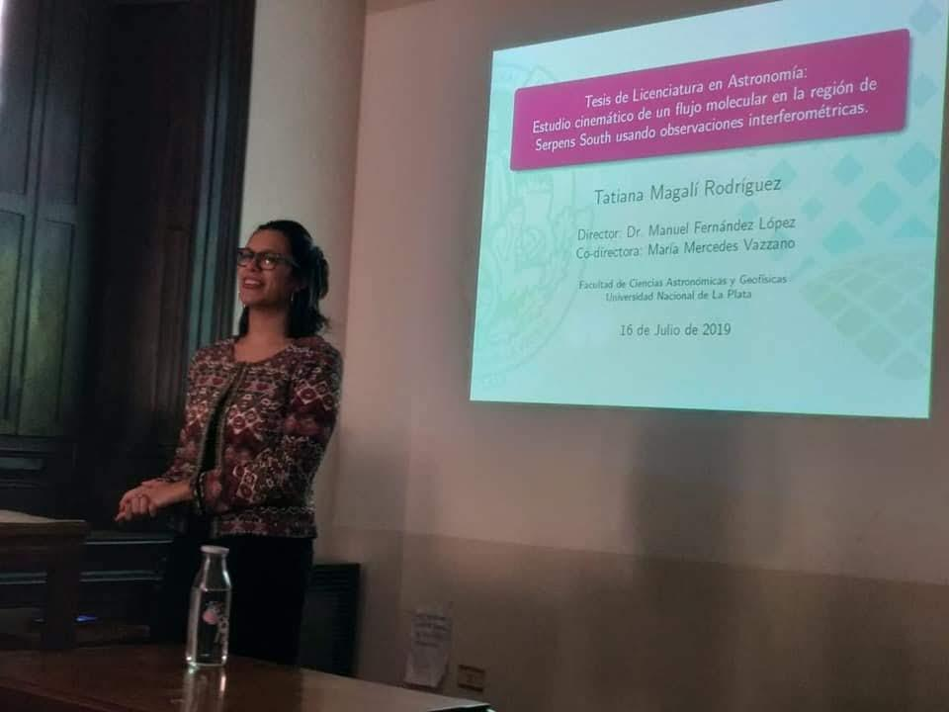
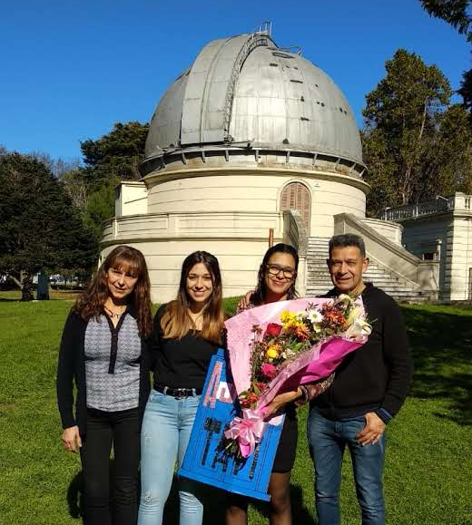
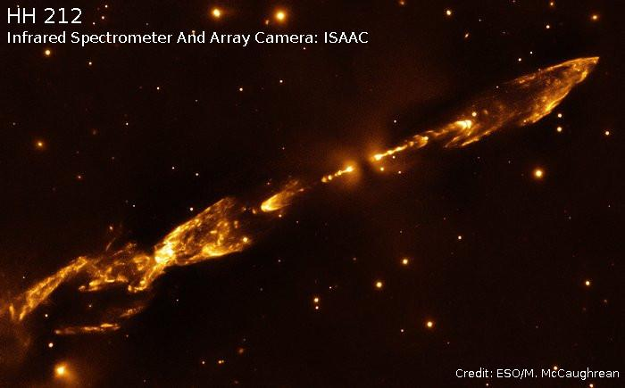
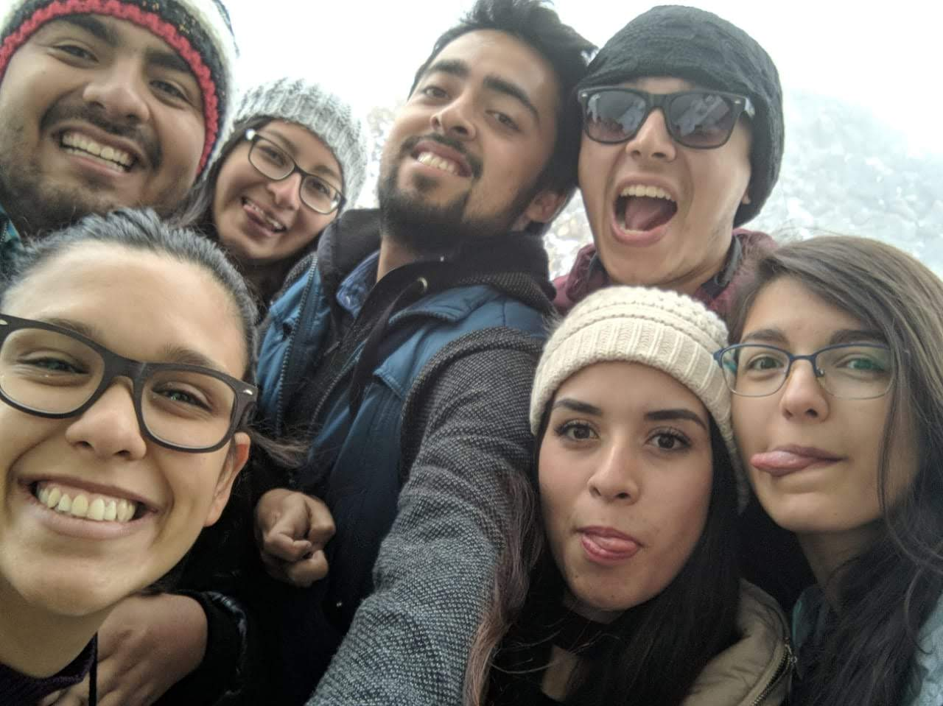
a little bit more about my experience
Recommendation letters
Online application
Intention letter
CV

Slide 4
In what area of astrophysics should I specialize?
What classes did I enjoy the most?
Who will I be working with?
Will I be able to continue this work after graduating?
Will this help me get a job?
Do I want to go into academia? What other options are there?

Slide 5
Colloquia and seminar talks at your school
Attend meetings and conferences
apply to workshops and internships
What kind of work is being done here?
Are they looking for student?
What’s new? What other options are there?
Experience the day to day work, find out what you like (and what you don’t like).

Slide 6
it will also help you prepare
Take notes, be critical, check different presentation styles, and adapt it to your work

Slide 7

BUT MOST IMPORTANT:
get to know other scientists and students!
Other students probably have the same questions and problems you do, plus they are you future colleagues!
We have all been where you are now, talk to young graduates and share your doubts!

Slide 8

be open
be resourceful
be ready to self-teach
but also...
You might not get exactly what you want
Get yourself some tools: learn a new language, a new programming language, get in contact with people that work on what you like
Your advisor might not always have the answers, or you might get a position where you are the “expert” on what you do

Slide 9
allow yourself to fail
believe in yourself
Don’t withdraw
Nobody is perfect, try not to measure your success based on other people's experiences. Reflect, take the best from the situation and learn.
Impostor syndrome attacks when you least expect it! You should also keep an eye for those toxic faculty members….
Study and working groups will help you keep your feet on the ground.
Also, there are things that are obvious, but only after some of working in science. Don’t spend days researching something that could be solved simply asking!

Slide 10
every step brings new challenges and things to learn
new instruments
Observer training and data reduction workshops will help with this!
proposals
You will need to get funding, get observing time. You will get better with time, I promise.
writing and publishing
Reading is key, reading a lot, and practice.
outreach is not less important
Don’t forget why are you doing science, and for whom!

Slide 11
every path is different

Slide 12
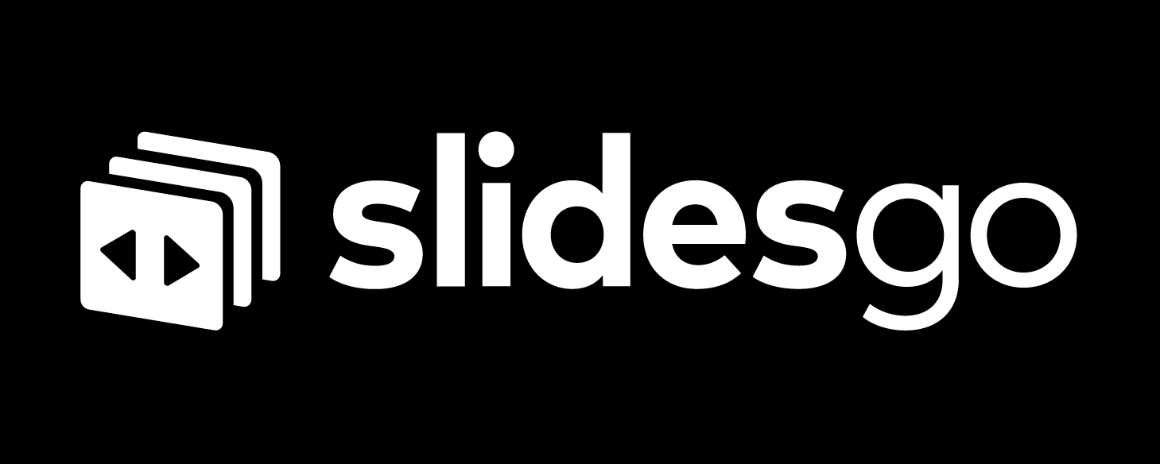
find out where your road will take you
find out where your road will take you
This presentation template was created by Slidesgo, including icons by Flaticon, and infographics & images by Freepik and illustrations by Storyset.

Slide 13
The American Astronomical Society: Internships and Summer Jobs
NRAO Student Programs
CALTECH LIGO Summer Undergraduate Research Fellowship
STScI Space Astronomy Science Program
JPL Summer Internship Program
The Leiden/ESA Astrophysics Program for Summer Students (The Netherlands)
International School for Young Astronomers (Mexico & South Africa)
ASTRON/JIVE Summer Research Programme (The Netherlands)
Summer Internships at MPIA (Germany)
ASIAA Summer Student Program (Taiwan)
International Astronomy Meetings

